Slide 1
B TREES
TEAM CCLEX
MEMBERS
Wayne Matthew Dayata
Hannah Ruth Labana
Ivan Ric Woogue
Marc Nathaniel Valeros

Slide 2


Who are the proponents of B-trees?
In 1972, Rudolf Bayer and Edward M. McCreight, both computer scientists, invented a data structure called “B-trees”
"Organization and Maintenance of Large Ordered Indexes”

Slide 3
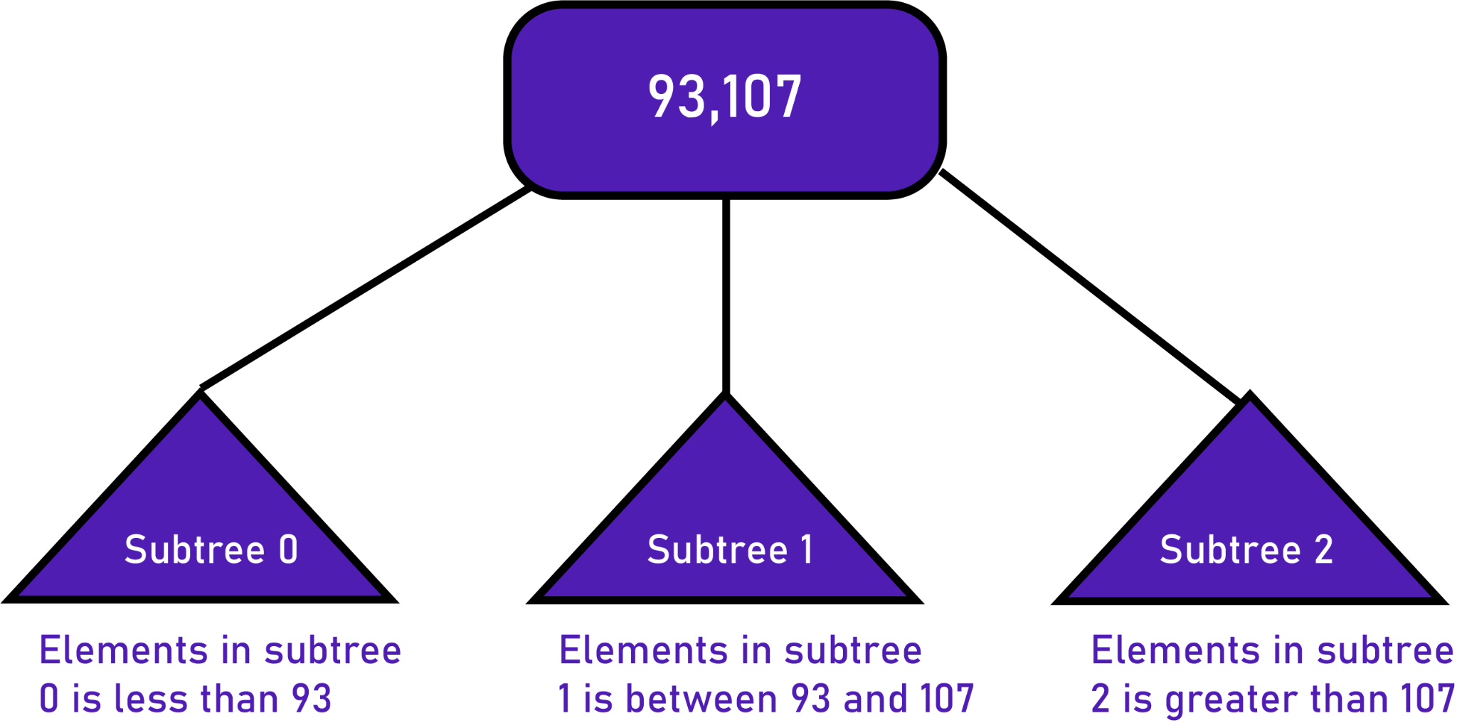
Why did they invent B-trees?
To access and maintain efficiently an index that is too large to hold in memory.
B-trees are a way to get better locality and limit the number of seek operations
Accessing a disk location takes about 5ms = 5,000,000ns, thus an efficient algorithm is needed.

Slide 4
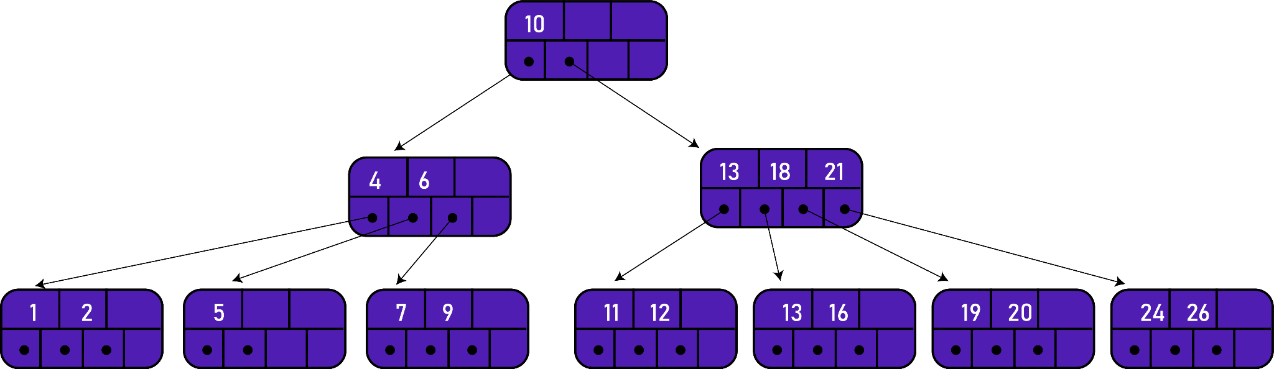
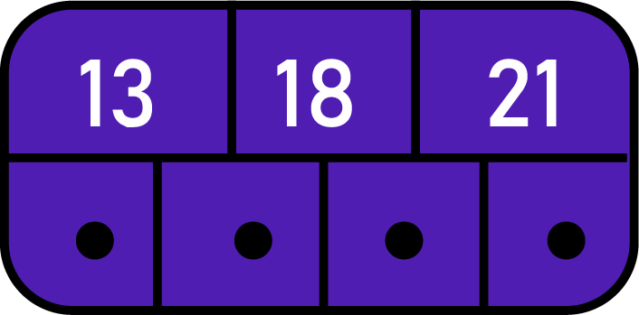
TERMS
01
Page or node
02
Order of B-tree
consists of an ordered sequence of keys and a set of pointers.
represents the upper bound on the number of immediate children a B Tree can have.
What is the order?
4
How many pages?
10

Slide 5
TERMS
03
Internal nodes
04
Leaf nodes
all nodes except for leaf nodes and the root node.
considered to be the lowest level of keys and the pointers do not lead to other pages(points to null)

Slide 6
CONCEPTS
A B-tree is a self-balancing tree data structure that keeps data sorted and allows searches, insertions, and deletions in logarithmic amortized time.
Time complexity to search, insert and delete is O(Log_{M} n) .
It is most commonly used in database management systems (DBMS) and file systems.

Slide 7
CONCEPTS
The height of B-Trees is kept low by putting maximum possible keys in a B-Tree node.
1,5 ,8,9,12,19,21,23,25,27,29,35,41,43,44,49,57,65,72
Let’s insert the values above in a B-tree of orders 5 & 7. Notice the height and distribution of the keys.

Slide 8
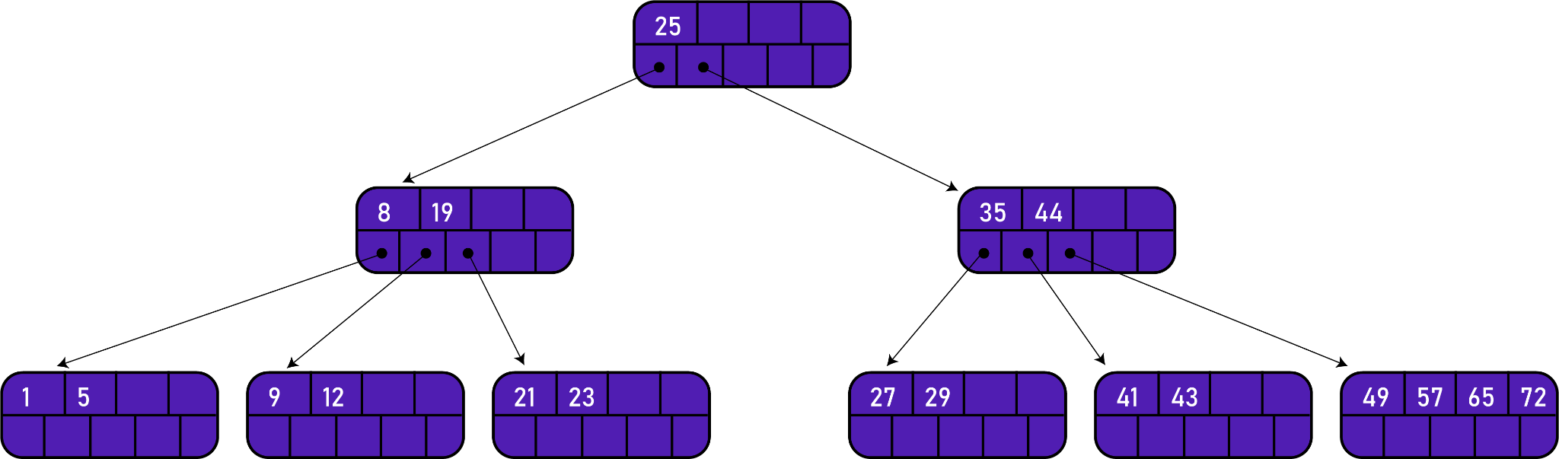
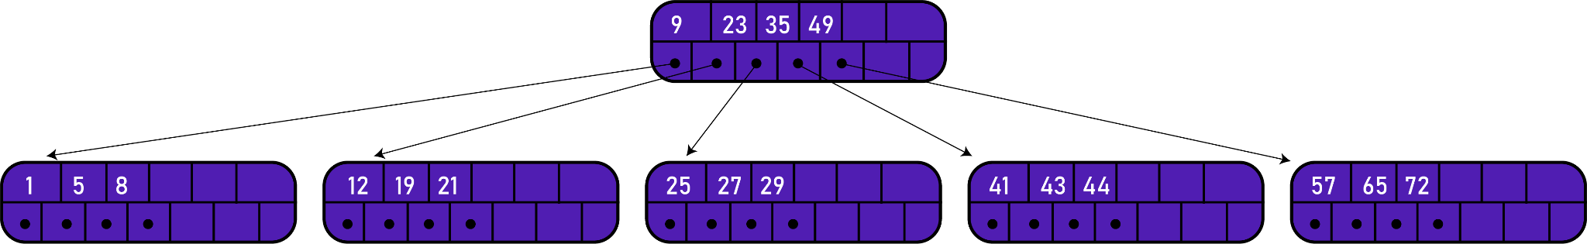
ORDER 5
ORDER 7
What are your observations?

Slide 9
Properties of a B-tree of order m:
Every page has a maximum of m descendents.
Every page, except for the root and the leaves, has at least m/2 descendents.
The root has at least two descendents.
All the leaves appear on the same level.
A non leaf page with m descendents contains m - 1 keys.
A leaf page contains at least (m/2) - 1 keys and no more than m - 1 keys.
All the key values within a node must be in ascending order.

Slide 10
Key Comparisons
Basis for Comparison | B-TREE | BINARY TREE
Essential constraint | A node can have at max M number of child nodes(where M is the order of the tree). | A node can have at most 2 children.
Usage | It is used when data is stored on disk. | It is used when records and data are stored in RAM.
Height of the tree | logM N (where m is the order of the M-way tree) | log2 N
Application | Code indexing data structure in many DBMS. | Code optimization, Huffman coding, etc.

Slide 11
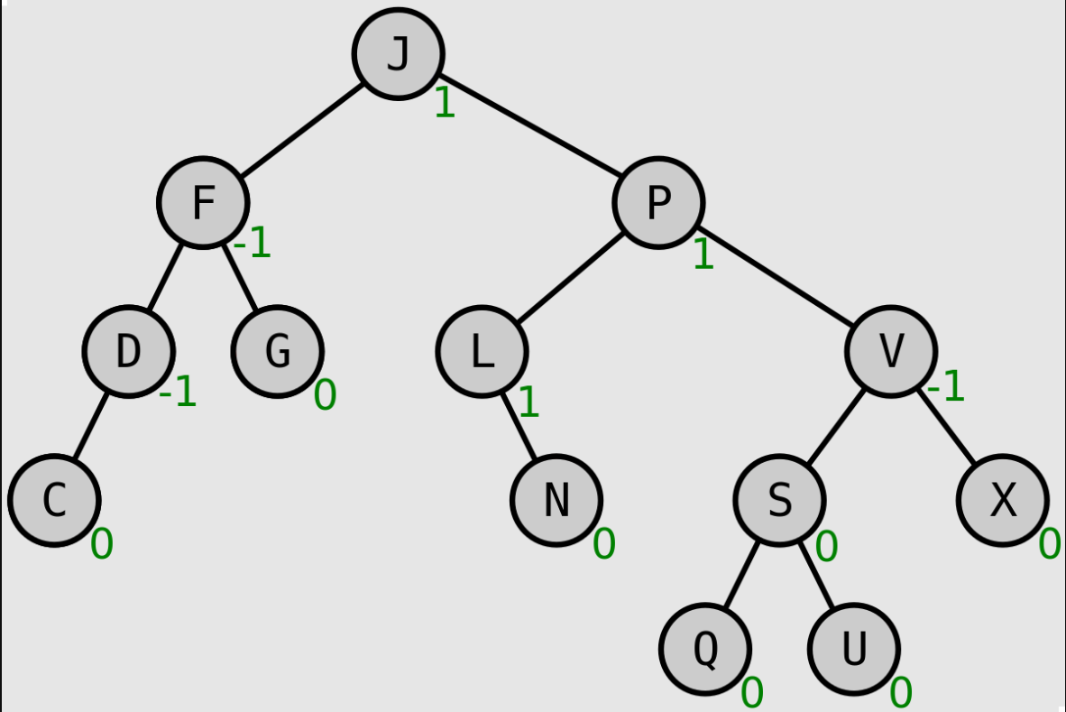
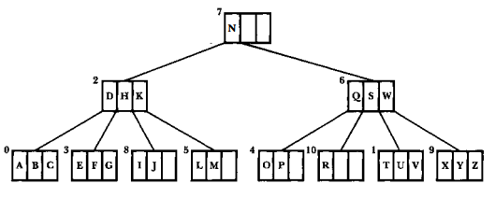
Binary Search Tree/AVL Tree vs B-Tree
On what direction does each of the trees grow?
How does this affect the search length of the tree's elements?
Are the access times consistent?

Slide 12
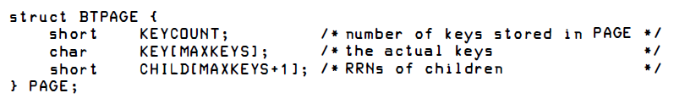
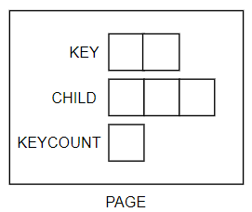
Original Version
What is this representing?
How do you define the data structure?
Source: File Structures (Second Edition) by Folk, Zoellick
Notes:
(start with a node/page, naay keys and pointers in between)
- need a keyCount to identify how many keys - b tree flexibility - naay #define Max to determine max keys per page (the order)
- simulate what happens if a page is full - splitting and promotion
- add to the data structure nga array of pages, and a field to signify the head, then clarify that the pointers means the page to continue the lookup

Slide 13
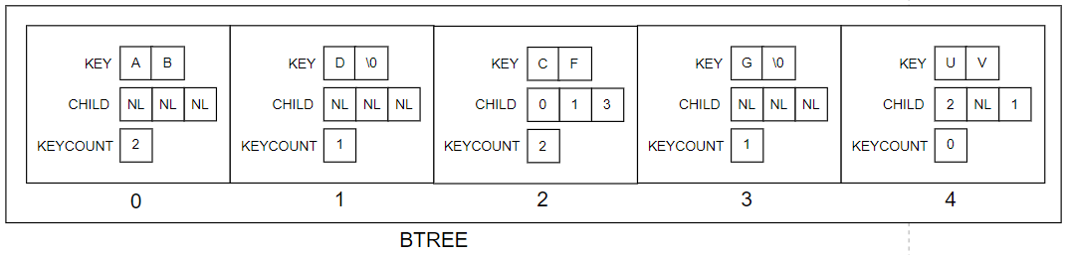
Original Version
#define MAXKEYS 2 // order of the B-Tree is 3
#define NL -1 // sentinel value for no child
#define MAX 5 // maximum pages will be 5
struct BTPAGE BTREE[MAX];
............ // statements to initialize and put some values in BTREE
Source: File Structures (Second Edition) by Folk, Zoellick
Notes:
(start with a node/page, naay keys and pointers in between)
- need a keyCount to identify how many keys - b tree flexibility - naay #define Max to determine max keys per page (the order)
- simulate what happens if a page is full - splitting and promotion
- add to the data structure nga array of pages, and a field to signify the head, then clarify that the pointers means the page to continue the lookup

Slide 14
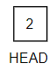
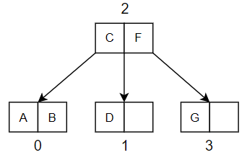
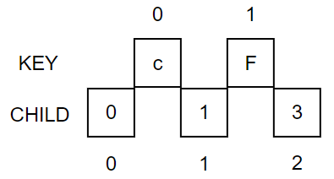
Original Version
Source: File Structures (Second Edition) by Folk, Zoellick

Slide 15
Operations in B-Tree
Search
Insert
Delete
Additional actions in B-Tree
Splitting
Promotion
Redistribution
Concatenation
More on these in our simulations ☺

Slide 16
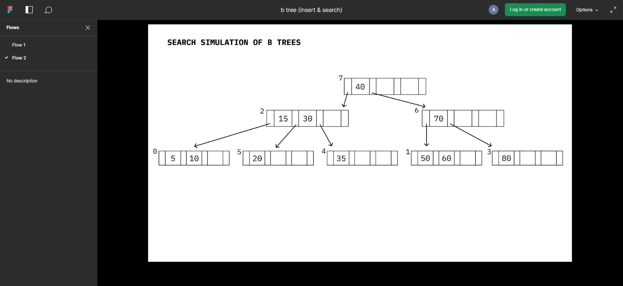
Search Simulation (Slides: https://www.figma.com/proto/dy7uUTTnXE0NTz18nSNTKo/b-tree-(insert-%26-search)?node-id=24%3A453&scaling=contain&page-id=0%3A1&starting-point-node-id=24%3A453&show-proto-sidebar=1

Slide 17
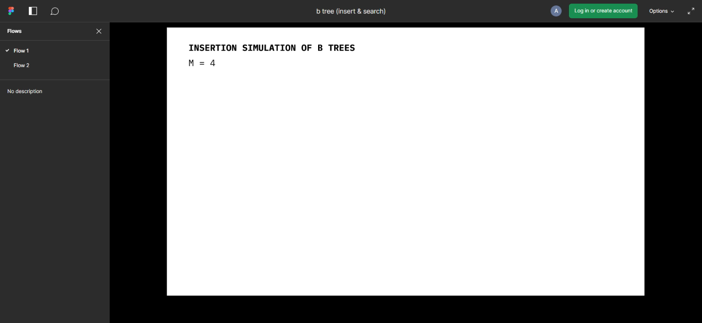
Insertion Simulation (Slides: https://www.figma.com/proto/dy7uUTTnXE0NTz18nSNTKo/b-tree-(insert-%26-search)?node-id=1%3A3&scaling=contain&page-id=0%3A1&starting-point-node-id=1%3A3&show-proto-sidebar=1

Slide 18
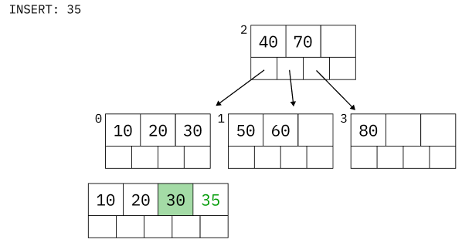
Insertion: Observations
Begins with a search that proceeds downward from the root to the leaf level.
After finding the insertion location at the leaf level, the work of insertion, splitting, and promotion proceeds upward from the bottom.

Slide 19
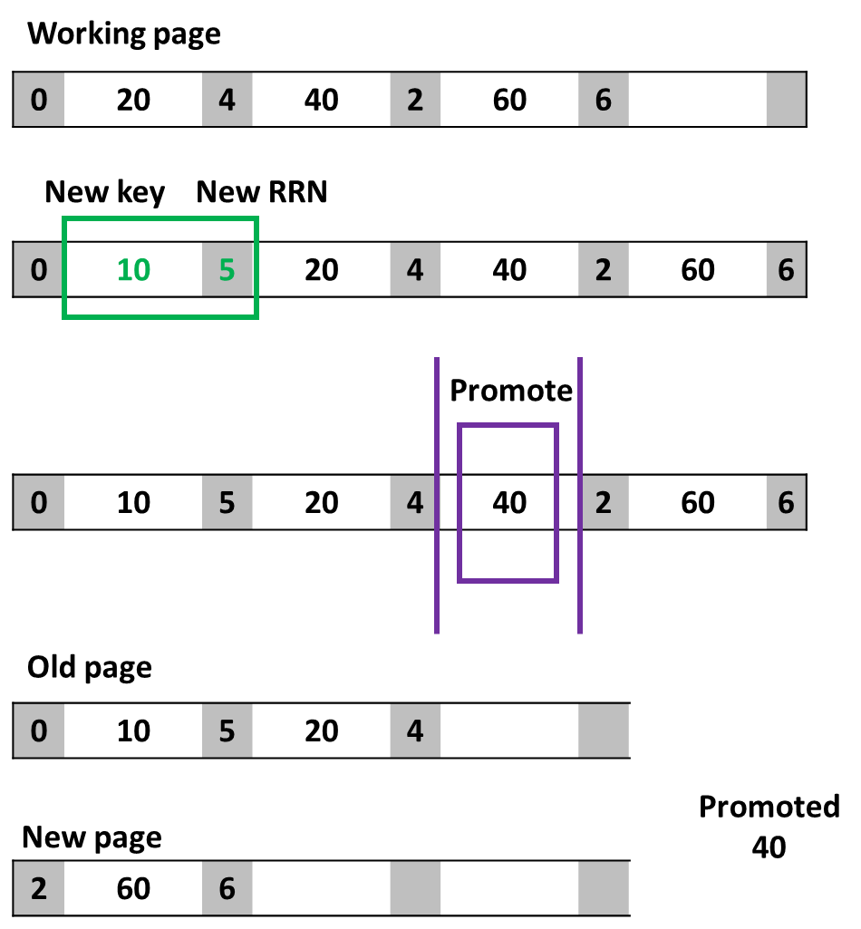
Splitting and Promotion
Original page
Prepare a working page
Must hold an extra key and child pointer.
Copy the contents from the original page to the working page.
Insert the new key and its RRN into the proper position of the working page.
Promote the middle key to the parent page.
Place contents to the left of the middle key back to the original page.
Place contents to the right of the middle key into a new page.
Note the new page's RRN.

Slide 20
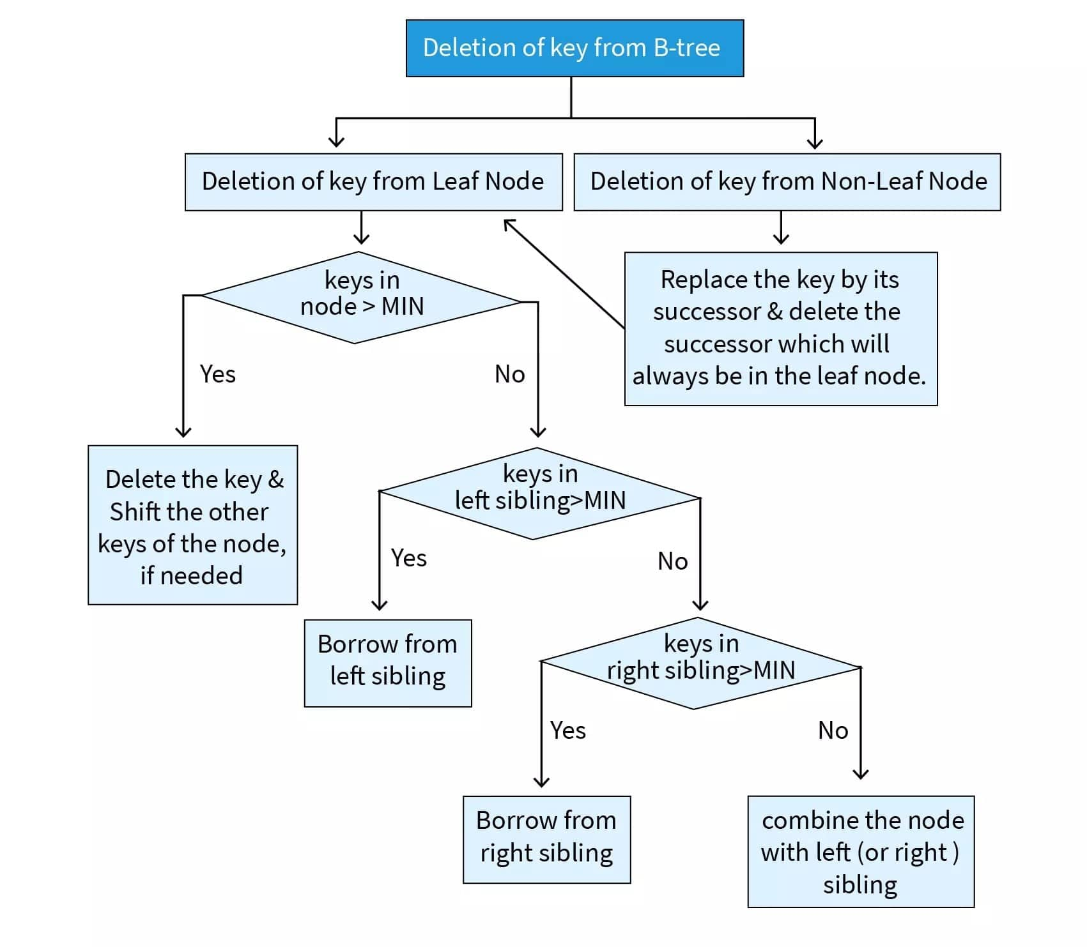
Deletion: Classification of cases
MIN = ⌈m/2⌉- 1
Replacement of successor
Shifting
Redistribution
Concatenation
Which among the processes are similar to that in binary search tree?
Check if parent node reaches MIN

Slide 21
Deletion Simulation
(Refer to attached PPT for the simulation)

Slide 22
Original Version
Common characteristic between the searching, inserting, and deletion operations
Recursive due to the subtasks of some operations:
Splitting and promotion
Redistribution and concatenation
Recursion keeps track of each level.
Source: File Structures (Second Edition) by Folk, Zoellick

Slide 23
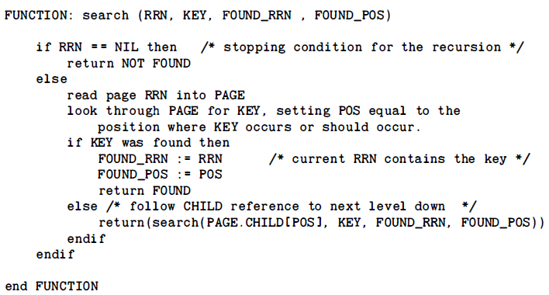
Original Version
Notes:
1. Return type can be an enum (FOUND, NOT_FOUND)
2. Very similar to searching in binary trees
3. No additional operations needed
Source: File Structures (Second Edition) by Folk, Zoellick

Slide 24
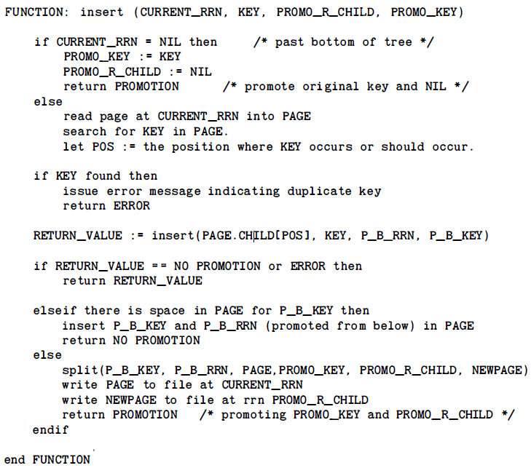
Original Version
Notes:
1. Insertion will always be done on the leaf
2. Return type can be an enum (PROMO, NO_PROMO, ERROR)
3. Duplicate keys are not allowed
4. Sort the page where key is inserted using inner loop of insertion
5. 3 main conditions
No promo
Promo with enough space
Promo no space (proceed to splitting)
Source: File Structures (Second Edition) by Folk, Zoellick

Slide 25
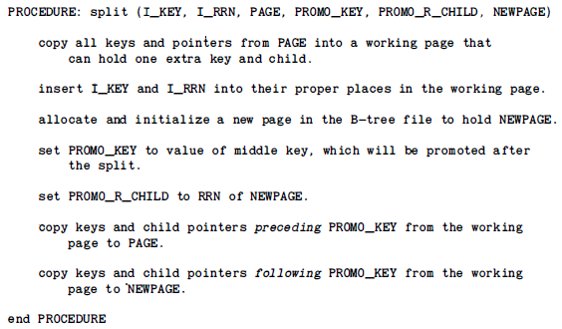
Original Version
Notes:
1. A working page with extra 1 key and child is created
2. Insert the key and its RC from previous call in its correct position
3. Median key is promoted
4. The new page is the right child of the promoted key
Source: File Structures (Second Edition) by Folk, Zoellick

Slide 26
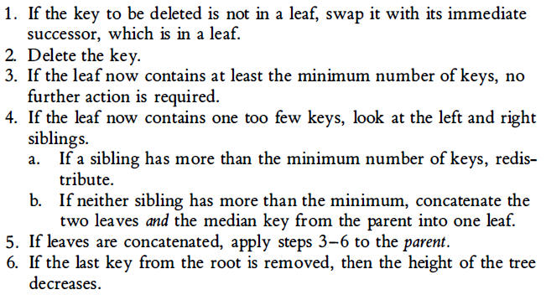
Breakdown of Original Version
Delete
Notes:
1. Deletion always happens on the leaf
2. If not on leaf, swap with immediate successor
3. Maintain the order of keys
4. Underflow - leaf contains less than minimum number of keys
(⌈ m/2 ⌉ - 1)
Source: File Structures (Second Edition) by Folk, Zoellick

Slide 27
Original Version
Redistribution
Notes:
1. It is assumed there is a sibling that has more than the minimum number of keys (⌈ m/2 ⌉ - 1)
2. Auxiliary array may or may not needed
3. Manipulate the key counts of the page to find the median
Find a sibling with more than the minimum number (⌈ m/2 ⌉ - 1) of keys
Think of the index of each key as if the parent key and all the keys in the left and right child are in the same array
Promote the median (n/2) key
The left keys to the median will be placed on the left child
The right keys to the median will be placed on the right child
Original parent key will be replaced by the promoted key
Source: File Structures (Second Edition) by Folk, Zoellick

Slide 28
Original Version
Concatenation
Notes:
1. It is assumed there is no sibling that has more than the minimum number of keys (⌈ m/2 ⌉ - 1)
2. At minimum 1 page is deleted which will be the sibling
3. At maximum 2 pages are deleted when the parent page contains 0 keys
Place the following the keys and their child pointers on the underflow page:
If underflow page is the left child of the parent
Keys of the underflow page
Parent key (do not copy the child pointers)
Keys of the right sibling
If underflow page is the right child of the parent
Keys of the left sibling
Parent key (do not copy the child pointers)
Keys of the underflow page
Source: File Structures (Second Edition) by Folk, Zoellick

Slide 29

Variation of B-Tree
Any ways to make our B-Tree operations more efficient?
YES!
Source: File Structures (Second Edition) by Folk, Zoellick

Slide 30
Variation of B-Tree
Any ways to make our B-Tree operations more efficient?
Perform redistribution along with splitting during insertion
(Bayer & McCreight, 1972)
Makes B-tree more space efficient
Quantify the efficiency by (space used / space created)
After 5,000 random insertions for a tree of order 121 (Bayer & McCreight, 1972)
67% space utilization - splitting
86% space utilization - redistribution
Source: File Structures (Second Edition) by Folk, Zoellick

Slide 31

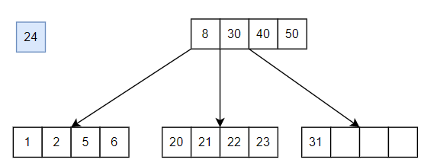
Variation of B-Tree (Redistribution)
GREEN => LEFTMOST OR RIGHTMOST KEY
BLUE => INSERTED KEY
RED =>DEMOTED PARENT KEY
Source: File Structures (Second Edition) by Folk, Zoellick

Slide 32
Variation of B-Tree (Redistribution)
GREEN => LEFTMOST OR RIGHTMOST KEY
BLUE => INSERTED KEY
RED =>DEMOTED PARENT KEY
Source: File Structures (Second Edition) by Folk, Zoellick

Slide 33
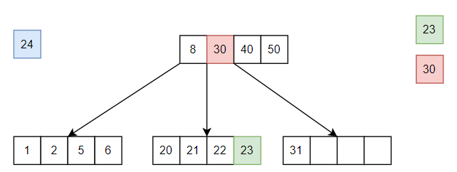
Variation of B-Tree (Redistribution)
GREEN => LEFTMOST OR RIGHTMOST KEY
BLUE => INSERTED KEY
RED =>DEMOTED PARENT KEY
Source: File Structures (Second Edition) by Folk, Zoellick

Slide 34
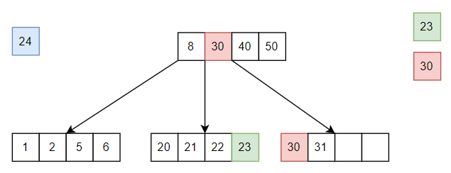
Variation of B-Tree (Redistribution)
GREEN => LEFTMOST OR RIGHTMOST KEY
BLUE => INSERTED KEY
RED =>DEMOTED PARENT KEY
IF LEFT SIBLING
Bigger key between blue key and green key will be the parent key
Source: File Structures (Second Edition) by Folk, Zoellick

Slide 35
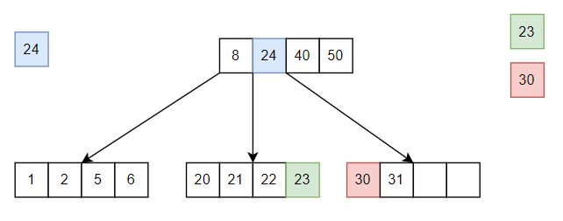
Variation of B-Tree (Redistribution)
GREEN => LEFTMOST OR RIGHTMOST KEY
BLUE => INSERTED KEY
RED =>DEMOTED PARENT KEY
IF LEFT SIBLING
Bigger key between blue key and green key will be the parent key
Source: File Structures (Second Edition) by Folk, Zoellick

Slide 36
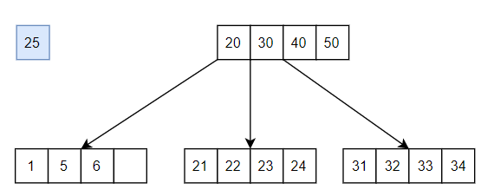
Variation of B-Tree (Redistribution)
GREEN => LEFTMOST OR RIGHTMOST KEY
BLUE => INSERTED KEY
RED =>DEMOTED PARENT KEY
Source: File Structures (Second Edition) by Folk, Zoellick

Slide 37
Variation of B-Tree (Redistribution)
GREEN => LEFTMOST OR RIGHTMOST KEY
BLUE => INSERTED KEY
RED =>DEMOTED PARENT KEY
Source: File Structures (Second Edition) by Folk, Zoellick

Slide 38
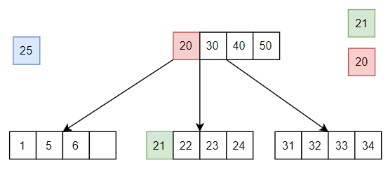
Variation of B-Tree (Redistribution)
GREEN => LEFTMOST OR RIGHTMOST KEY
BLUE => INSERTED KEY
RED =>DEMOTED PARENT KEY
Source: File Structures (Second Edition) by Folk, Zoellick

Slide 39
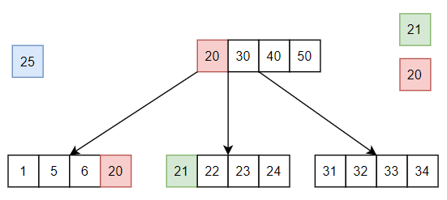
Variation of B-Tree (Redistribution)
IF LEFT SIBLING
Smaller key between blue key and green key will be the parent key
GREEN => LEFTMOST OR RIGHTMOST KEY
BLUE => INSERTED KEY
RED =>DEMOTED PARENT KEY
Source: File Structures (Second Edition) by Folk, Zoellick

Slide 40
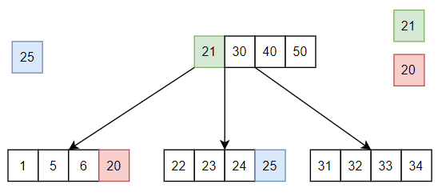
Variation of B-Tree (Redistribution)
IF LEFT SIBLING
Smaller key between blue key and green key will be the parent key
GREEN => LEFTMOST OR RIGHTMOST KEY
BLUE => INSERTED KEY
RED =>DEMOTED PARENT KEY
Source: File Structures (Second Edition) by Folk, Zoellick

Slide 41
Variation of B-Tree
B+ Tree and B* Tree
All data pointers are stored in the leaf nodes
Internal nodes are for navigation
All leaf nodes are connected through linked list

Slide 42
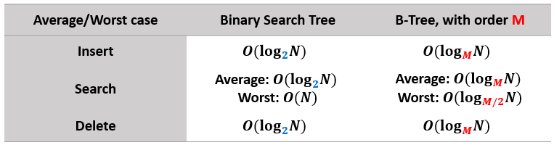
Efficiency Analysis: Time Complexity
When the order of B-Tree increases,
More elements can be stored per page
Overall tree height decreases
Number of steps for the search procedure decreases as the depth decreases
Therefore, search efficiency improves.
Remember, we want our B-Trees to be broad and shallow, instead of narrow and deep.

Slide 43
Streamline Code
Downlod the source file here (double click in the editor view):
Or view the succeeding slides.
Source: File Structures (Second Edition) by Folk, Zoellick

Slide 44
Streamline Code (Data structure definitions)
typedef struct{
BTree node;
int index;
}location;
typedef struct{
boolean isSuccess; //TRUE, FALSE
boolean isPromote; //TRUE, FALSE
BTree newRChild; //if isPromote == TRUE
int newKey; //if isPromote == TRUE
}insertStatus;
typedef struct{
boolean isDeleted;
int itemRemoved;
int nodeCount; //needed in case of redis. or concatenation
}deleteStatus;
typedef struct{
int LSCount; //-1 is does not exist
int RSCount; //-1 if does not exist
BTree LS, RS;
}siblingStatus;
#include <stdio.h>
#include <stdlib.h>
#include <string.h>
#include <math.h> //to get min nodes for ceil()
//B-Tree settings
#define MAXKEYS 3
#define ORDER MAXKEYS+1
#define MIN (int)(ceil((ORDER)/2))-1
//Sentinel values
#define NL -1
typedef struct node{
int count; //number of keys used
int elem[MAXKEYS]; //elements in the node
struct node *link[ORDER]; //child pointers
}page, *BTree;

Slide 45
Streamline Code (Search)
void search(BTree B, int elem){
location loc;
loc = searchRecur(B,elem);
if(loc.node == NULL){
printf("\nElement %d not found.", elem);
} else {
printf("\nElement %d found at address %x, index %d.",loc.node,loc.index);
}
}
location searchRecur(BTree B, int elem){
location ret = {NULL, NL};
int x;
if(B!=NULL){
for(x=0;x<B->count && B->elem[x] < elem;x++){} //traverse through node
if(x<B->count && B->elem[x] == elem){ //element found
ret.node = B;
ret.index = x;
} else {
ret = searchRecur(B->link[x],elem); //RECURSIVE search
}
} //else NULL reached, element not found
return ret;
}

Slide 46
Streamline Code (Traversal)
void displayInOrder(BTree B){ //left, root, right
int x;
if(B!=NULL){
for(x=0;x<=B->count;x++){
displayInOrder(B->link[x]);
if(x<B->count){
printf("\n%-15x %-6d %-6d",B,x,B->elem[x]);
}
}
}
}
void displayPreOrder(BTree B){ //root, left, right
int x;
if(B!=NULL){
for(x=0;x<B->count;x++){
printf("\n%-15x %-6d %-6d",B,x,B->elem[x]);
}
for(x=0;x<=B->count;x++){
displayPreOrder(B->link[x]);
}
}
}

Slide 47
Streamline Code (Insert - initial call)
void insertElem(BTree *B, int elem){
insertStatus stat;
printf("\n\nInserting element: %d",elem);
stat = insertRecur(B,elem);
if(stat.isPromote==TRUE){
createRoot(B, stat.newKey, stat.newRChild);
printf("\nInsertion successful, and created new root (Address: %x).",*B);
} else if(stat.isSuccess == FALSE) {
printf("\nInsertion failed - element already exists.");
} else {
printf("\nInsertion successful, within existing tree body");
}
}

Slide 48
Streamline Code (Insert - recursive)
insertStatus insertRecur(BTree *B, int elem){
insertStatus ret = {FALSE,FALSE,NULL,-1};
int x;
if(*B==NULL){ //leaf is reached, go back 1 level
ret.isPromote = TRUE;
ret.newKey = elem;
ret.newRChild = ret.newRChild;
} else {
for(x=0;x<(*B)->count && (*B)->elem[x] < elem;x++){} //search in page
if(x==(*B)->count || (*B)->elem[x] != elem){ //check if element does not exist
ret = insertRecur(&(*B)->link[x],elem); //RECURSIVE insert call
if(ret.isPromote == TRUE){ //check if there are any values promoted
if((*B)->count < MAXKEYS){ //check if there is free space
for(x=(*B)->count; x>0 && (*B)->elem[x-1] > elem; x--){
(*B)->elem[x] = (*B)->elem[x-1]; //shift existing elements and pointers
(*B)->link[x+1] = (*B)->link[x];
}

Slide 49
Streamline Code (Insert - recursive)
(*B)->count++; //insert the new element and pointer
(*B)->elem[x] = ret.newKey;
(*B)->link[x+1] = ret.newRChild;
ret.isPromote = FALSE;
ret.isSuccess = TRUE;
} else {
ret = split(B,ret.newKey,ret.newRChild); //perform splitting
}
} //else no promotion - either insertion done or failed
} //else no insertion - element found
}
return ret;
}

Slide 50
Streamline Code (Insert - splitting and promotion)
insertStatus split(BTree *B, int elem, BTree child){
insertStatus ret = {FALSE,FALSE,NULL,-1};
int tempKeys[MAXKEYS+1]; //create working page
BTree tempChild[MAXKEYS+2];
int x, mid;
BTree temp = (BTree)calloc(1,sizeof(page)); //allocate new page
if(temp != NULL){
memcpy(tempKeys,(*B)->elem,(*B)->count*sizeof(int)); //copy from old page to working page
memcpy(tempChild,(*B)->link,((*B)->count+1)*sizeof(BTree));
for(x=(*B)->count; x>0 && (*B)->elem[x-1] > elem; x--){ //shift existing elements and pointers
tempKeys[x] = tempKeys[x-1];
tempChild[x+1] = tempChild[x];
}
tempKeys[x] = elem; //insert the new element and pointer
tempChild[x+1] = child;

Slide 51
Streamline Code (Insert - splitting and promotion)
mid = MAXKEYS/2; //move back first half at original
memcpy((*B)->elem,tempKeys,(mid+1)*sizeof(int));
memcpy((*B)->link,tempChild,(mid+2)*sizeof(BTree));
(*B)->count = mid+1;
ret.isPromote = TRUE; //promote mid+1 and its child
ret.newKey = tempKeys[mid+1];
ret.newRChild = temp;
memcpy(temp->elem,tempKeys+mid+2,(MAXKEYS-mid-1)*sizeof(int)); //place rest of elements at new page
memcpy(temp->link,tempChild+mid+2,(MAXKEYS-mid)*sizeof(BTree));
temp->count = MAXKEYS-mid-1;
}
return ret;
}

Slide 52
Streamline Code (Delete - initial call)
void deleteElem(BTree *B, int elem){
deleteStatus stat;
printf("\n\nDeleting element: %d",elem);
stat = deleteRecur(B,elem);
if(stat.isDeleted== FALSE){
printf("\nDeletion failed - element does not exist.");
} else if(stat.nodeCount==0) {
//update root
printf("\nDeletion successful, tree height decreased (New root address: %x).",*B);
} else {
printf("\nDeletion successful.");
}
}

Slide 53
Streamline Code (Delete - recursive)
deleteStatus deleteRecur(BTree *B, int elem){
deleteStatus ret = {FALSE,-1,-1};
siblingStatus sib;
int x, y, min, src, ndx;
sideType side;
if(*B!=NULL){
for(x=0;x<(*B)->count && (*B)->elem[x] < elem;x++){}
if(x<(*B)->count && (*B)->elem[x] == elem){ //element found
ret.isDeleted = TRUE;
for(y=0;y<ORDER && (*B)->link[y] == NULL; y++){}
if(y==ORDER){ //is leaf
ret.itemRemoved = elem;
ret.nodeCount = --(*B)->count;
for(y=x; y<(*B)->count; y++){
(*B)->elem[y] = (*B)->elem[y+1]; //shift existing elements and pointers
(*B)->link[y+1] = (*B)->link[y+2];
}
return ret;
} else { //replace with successor
min = findMin((*B)->link[x+1]);
(*B)->elem[x] = findMin((*B)->link[x+1]);
ret = deleteRecur(&(*B)->link[x+1],min);
}
} else { //RECURSIVE search
ret = deleteRecur(&(*B)->link[x],elem);
}

Slide 54
Streamline Code (Delete - recursive)
if(ret.isDeleted == TRUE && ret.nodeCount < MIN){ //not enough keys in manipulated node
printf("\nUnderflow detected!");
ndx = (ret.itemRemoved < (*B)->elem[x]) ? x : x+1;
sib = checkSiblings(*B,ndx); //check siblings
printf("\nItem removed: %d",ret.itemRemoved);
printf("\nNode count: %d",ret.nodeCount);
printf("\nSiblings: %x %d - %x %d\n",sib.LS,sib.LSCount,sib.RS,sib.RSCount);
src = (sib.LSCount > sib.RSCount) ? sib.LSCount : sib.RSCount;
side = (sib.LSCount > sib.RSCount) ? LEFT : RIGHT;
printf("\nSibling chosen: %s", side==LEFT ? "Left" : "Right");
if(src >= MIN + 1){ //redistribution
printf("\nPerforming redistribution:");
redistribute((*B)->link[ndx],(*B)->link[ndx+side],*B,ndx,side);
} else { //concatenation
printf("\nPerforming concatenation:");
concatenate((*B)->link[ndx],(*B)->link[ndx+side],*B,ndx,side);
}
}
ret.nodeCount = (*B)->count;
} //else NULL reached, element not found
return ret;
}

Slide 55
Streamline Code (Delete - findMin() and checkSiblings() )
int findMin(BTree B){
int ret;
if(B->link[0]==NULL){
ret = B->elem[0];
} else {
ret = findMin(B->link[0]);
}
return ret;
}
siblingStatus checkSiblings(BTree B, int ptrNdx){
siblingStatus ret;
ret.LSCount = (ptrNdx>0) ? B->link[ptrNdx-1]->count : -1;
ret.RSCount = (ptrNdx<B->count) ? B->link[ptrNdx+1]->count : -1;
ret.LS = (ptrNdx>0) ? B->link[ptrNdx-1] : NULL;
ret.RS = (ptrNdx<B->count) ? B->link[ptrNdx+1] : NULL;
return ret;
}

Slide 56
Streamline Code (Delete - redistribution)
void redistribute(BTree dest,BTree src,BTree parent,int parentNdx,sideType side){
int x; //in this code, only 1 element gets redistributed
if(side==LEFT){ //destination shifts then source transfers
for(x=dest->count;x>0;x--){
dest->elem[x] = dest->elem[x-1];
dest->link[x+1] = dest->link[x];
}
dest->link[x+1] = dest->link[x];
dest->elem[0] = parent->elem[parentNdx-1];
dest->link[0] = src->link[src->count];
parent->elem[parentNdx-1] = src->elem[src->count-1];
}else{ //source transfer then source shifts
dest->elem[dest->count] = parent->elem[parentNdx];
dest->link[dest->count+1] = src->link[0];
parent->elem[parentNdx] = src->elem[0];
for(x=0;x<src->count-1;x++){
src->elem[x] = src->elem[x+1];
src->link[x] = src->link[x+1];
}
src->link[x] = src->link[x+1];
}
dest->count++;
src->count--;
}

Slide 57
Streamline Code (Delete - concatenation)
void concatenate(BTree dest,BTree src,BTree parent,int parentNdx,sideType side){
int x,y;
if(side==LEFT){
for(x=dest->count;x>0;x--){
dest->elem[x+src->count] = dest->elem[x-1];
dest->link[x+1+src->count] = dest->link[x];
}
dest->elem[src->count]=parent->elem[parentNdx];
dest->link[1+src->count]=src->link[src->count];
for(x=src->count-1;x>=0;x--){
dest->elem[x]=src->elem[x];
dest->link[x]=src->link[x];
}
dest->count += src->count + 1;
parent->count--;
free(parent->link[parentNdx]);
parent->link[parentNdx] = NULL;
for(x=parentNdx;x<parent->count;x++){
parent->elem[x] = parent->elem[x+1];
parent->link[x] = parent->link[x+1];
}
parent->link[x]=parent->link[x+1];
}else{
dest->elem[dest->count] = parent->elem[parentNdx];
dest->link[dest->count+1] = src->link[0];
y=dest->count+1;
for(x=0;x<src->count;x++){
dest->elem[y] = src->elem[x];
dest->link[y+1] = src->link[x+1];
}
dest->count += src->count + 1;
parent->count--;
free(parent->link[parentNdx+1]);
parent->link[parentNdx+1] = NULL;
for(x=parentNdx;x<parent->count;x++){
parent->elem[x] = parent->elem[x+1];
parent->link[x+1] = parent->link[x+2];
}
}
}

Slide 58





THE END
Thank you for listening!
Presented by:
Hannah Labana
Ivan Woogue
Marc Valeros
Wayne Dayata

